Slide 1
Knowledge Graphs
Tomoe Mizutani
11/13/2018

Slide 2
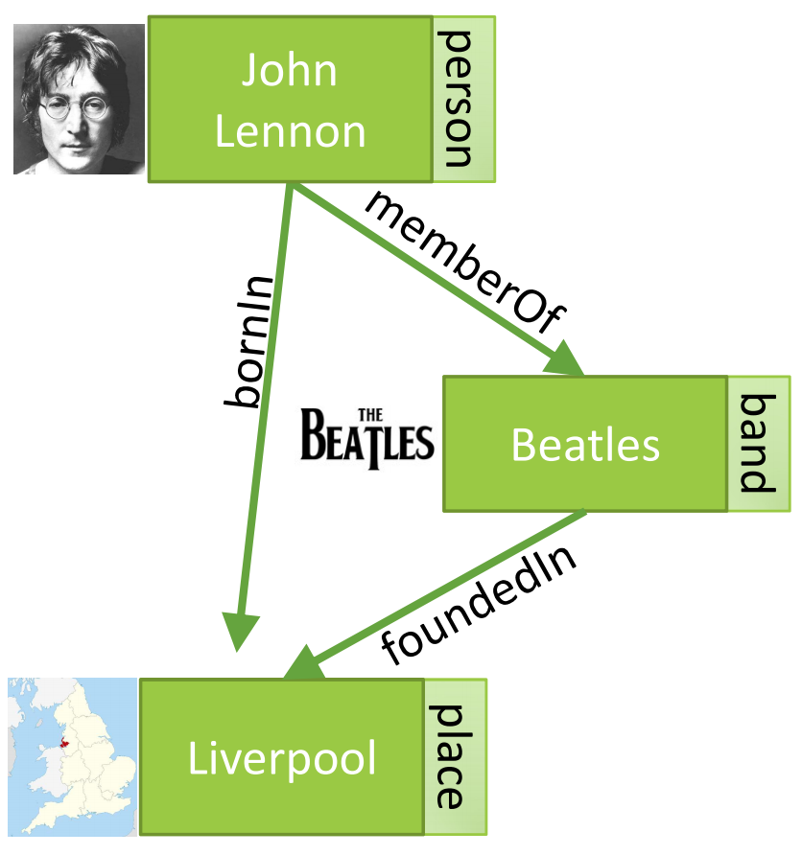
What is a Knowledge Graph?
Graph of knowledge!
Describes real world entities and their interrelations, organized in a graph
Motivation
Need a semantically structured way of representing information that is interpretable by computers
We are surrounded by entities that are connected by relationships
Graphs can be managed efficiently
(https://kgtutorial.github.io/)

Slide 3
What is a Knowledge Graph?
Components
Node: entities
Labels: attributes, types
Edges: relationship between entities
Represented by SPO Triples
(John Lennon, memberOf, Beatles)
(Beatles, foundedIn, Liverpool)
(https://kgtutorial.github.io/)

Slide 4
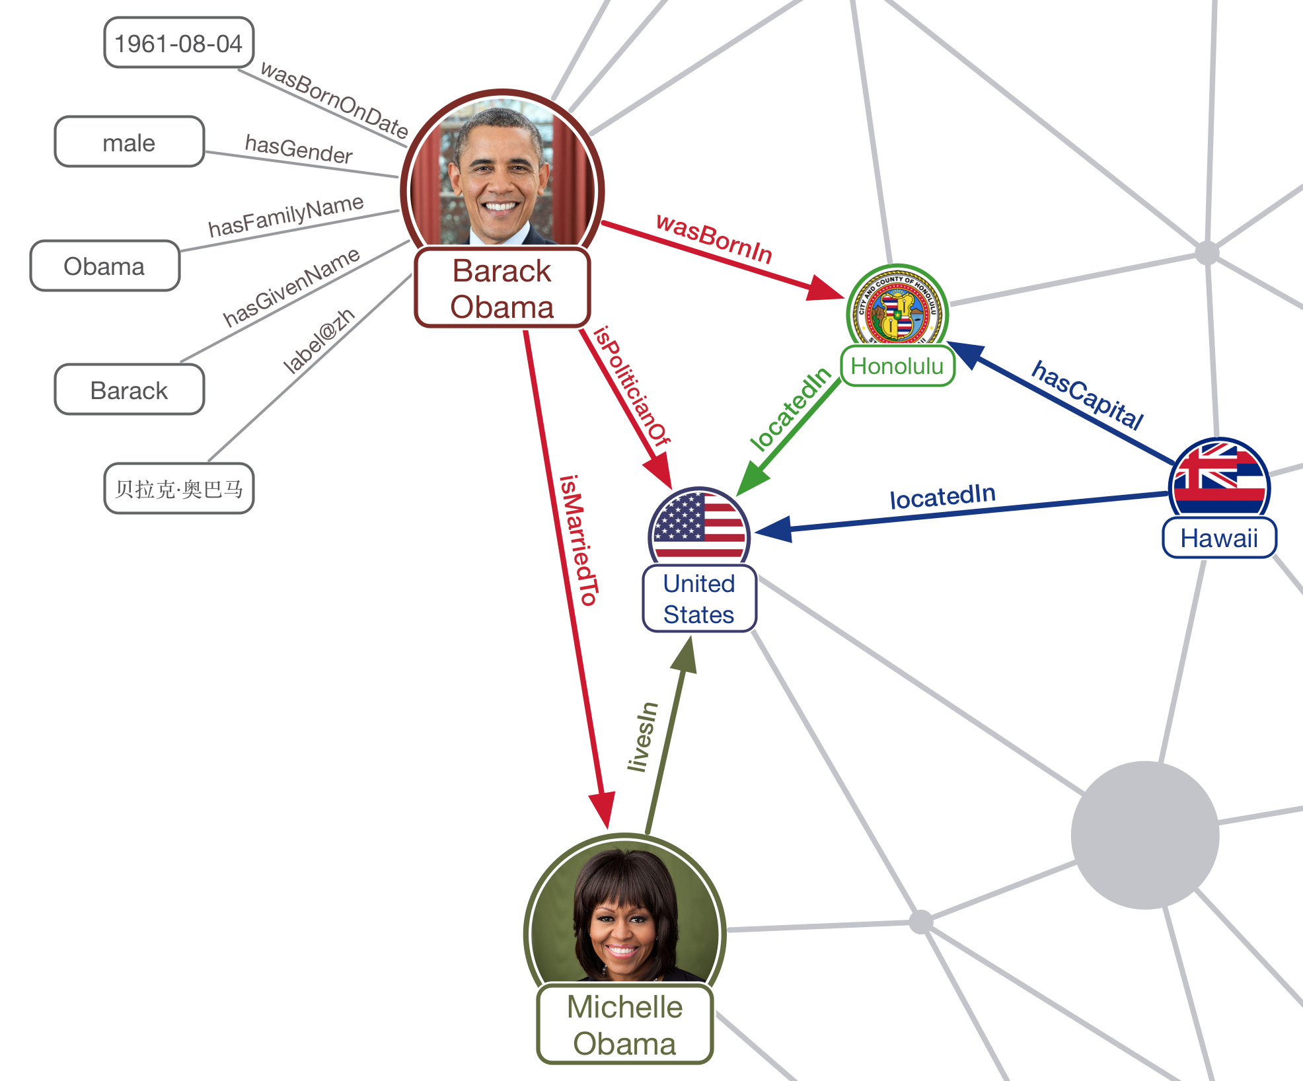
A slightly more complicated example:
https://www.ambiverse.com/knowledge-graphs-encyclopaedias-for-machines/

Slide 5
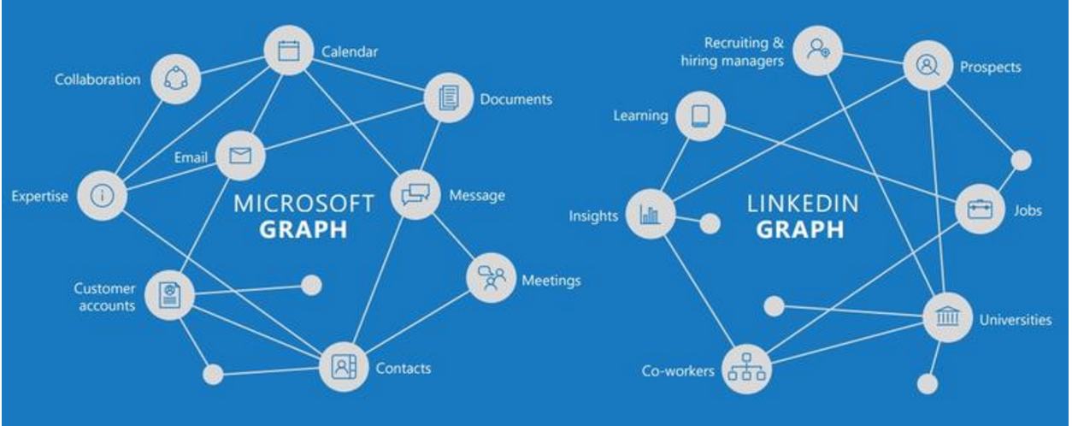
Examples:
Google Knowledge Graph
https://developers.google.com/knowledge-graph/
Amazon Product Graph
Facebook Graph API
https://developers.facebook.com/docs/graph-api/
IBM Watson Discovery KG
https://console.bluemix.net/docs/services/discovery/building-kg.html#watson-discovery-knowledge-graph
Microsoft Satori
LinkedIn Knowledge Graph

Slide 6

Google Knowledge Graph (2012)
570 million entities and 18 billion facts
Predictively complete entities in search box
Enrich search results with semantically structured summaries
Provide links to related entities in exploratory search
Freebase (2007)
Collaborative Knowledge Base
Allowed end-users to contribute to the KG by editing structured data
Harvested knowledge from structured data
Sources: Wikipedia, MusicBrainz, etc
Acquired by Google in 2010

Slide 7
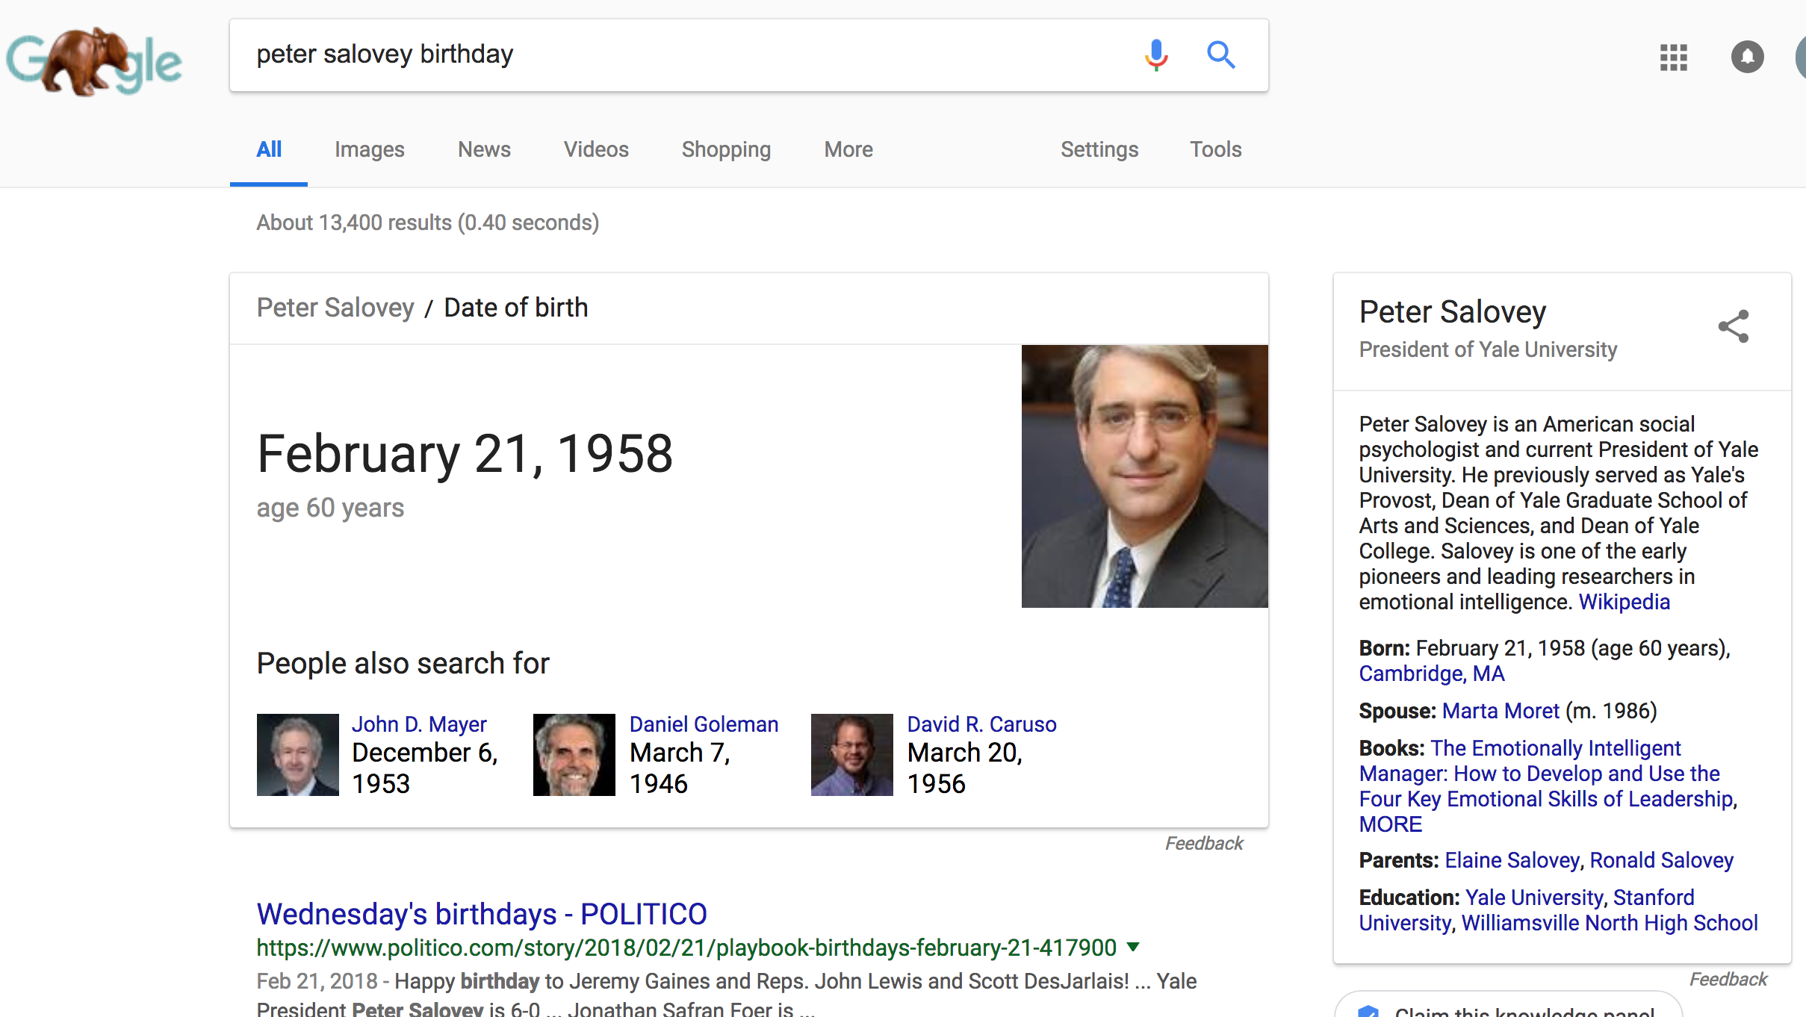
Google Knowledge Graph
Notes:
How it was created

Slide 8
Topics
Knowledge Extraction
NER, relation extraction
Knowledge Graph Construction
Probabilistic models
Knowledge Graph Completion
Entity and relation embedding
Knowledge Graph Querying and Applications
Recommender systems, question answering...

Slide 9
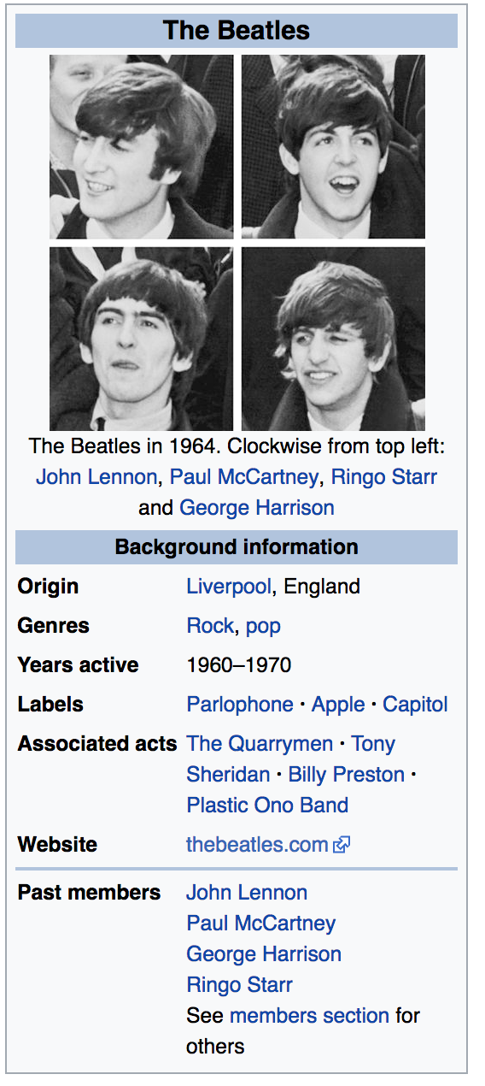
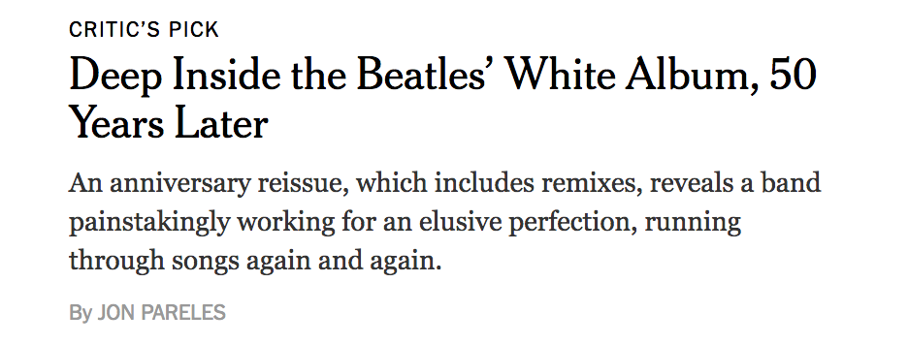
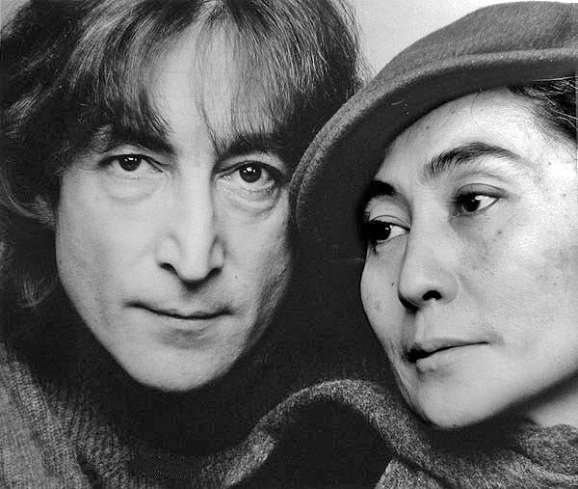
Information Extraction
Source of Knowledge
Structured Text
Unstructured Text
Images/Videos
Main questions:
Who are the entities?
Named Entity Recognition
What are their attributes?
NER, relation extraction
How are they related?
Relation Extraction

Slide 10

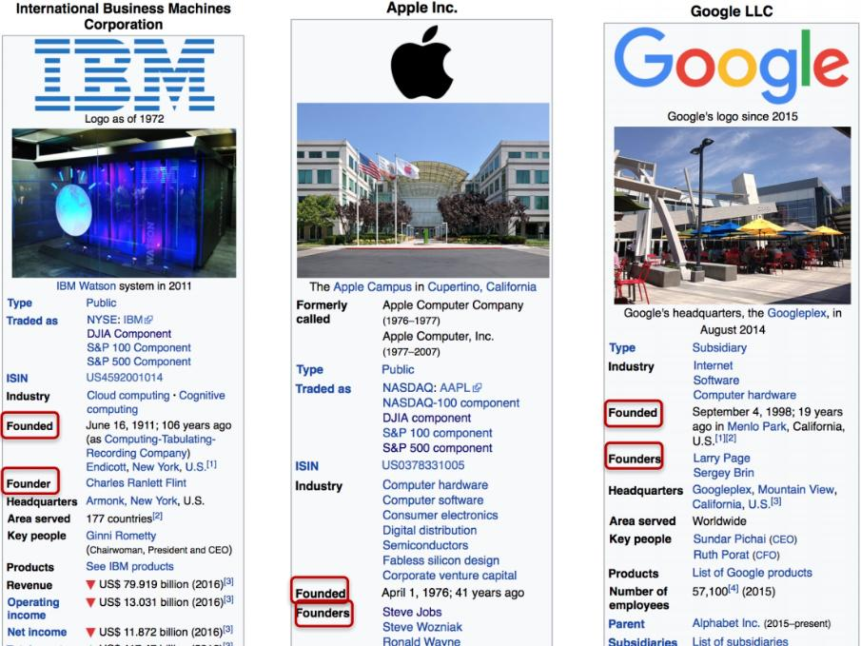
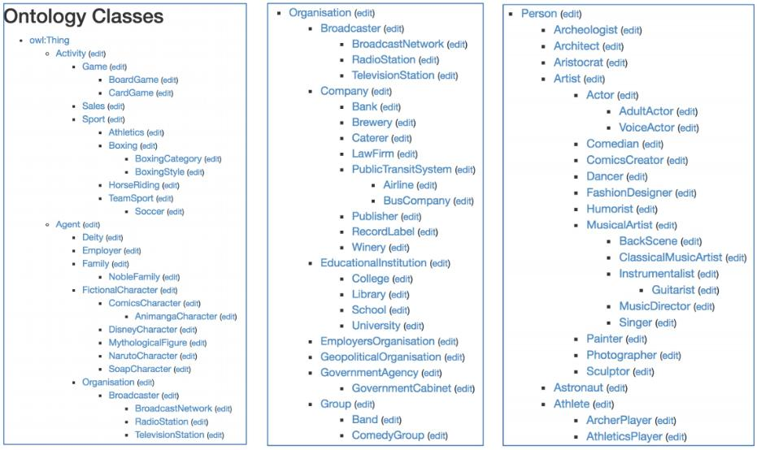
Structured Text
DBPedia (2007): project that aims to extract structured content from Wikipedia
3 billion triples, 580 million of which extracted from English page
Infobox tables Categories
https://wiki.dbpedia.org/about
Notes:
Can use regex

Slide 11

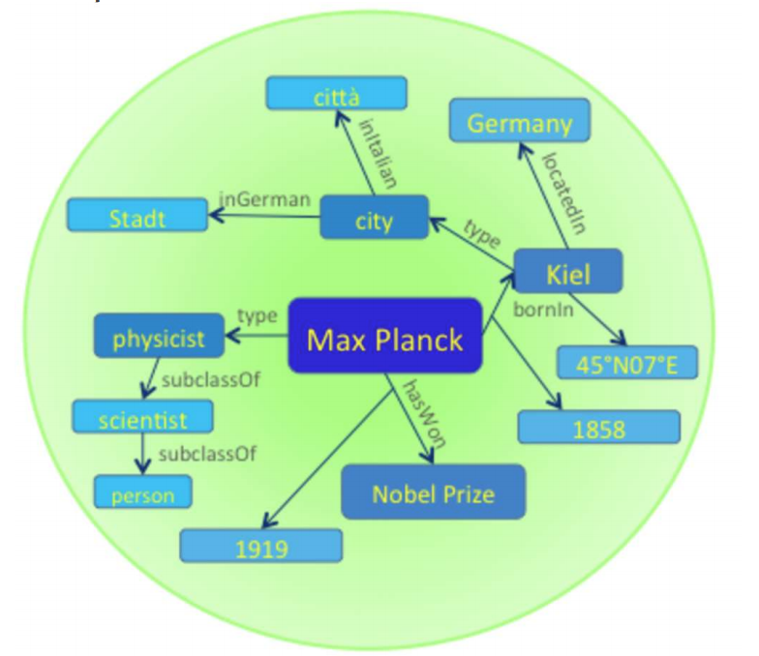
YAGO(2008)
Yet Another Great Ontology
350K entity types, 10M entities, 120M facts
Rich ontology: integrating entities from Wikipedia with classes in WordNet
~100 manually defined relations
Rules
Factual
Implication
Replacement
Temporal and spatial information?
https://www.mpi-inf.mpg.de/departments/databases-and-information-systems/research/yago-naga/yago/
Notes:
http://resources.mpi-inf.mpg.de/yago-naga/yago/publications/aij.pdf

Slide 12
YAGO2 (2012)
Incorporates temporal and spatial knowledge
Knowing not only that a fact is true, but also when and where it was true.
“Give me all songs that Bruno Mars wrote after Marry You”
SPOTL rather than SPO representation
Temporal Knowledge: Use Wikipedia
Time frame: people, buildings, events → start time and end time
Time point: work of art, literature, etc → start time only
Spatial Knowledge: Use Wikipedia and GeoNames
GeoNames: contain more than 7 million locations, has hierarchical classes for places
Integrate geo-entities from Wikipedia and GeoNames into YAGO2
Notes:
http://delivery.acm.org/10.1145/1970000/1963296/p229-hoffart.pdf?ip=130.132.173.38&id=1963296&acc=ACTIVE%20SERVICE&key=AA86BE8B6928DDC7%2E25D92BB326E6095D%2E4D4702B0C3E38B35%2E4D4702B0C3E38B35&__acm__=1541717006_6bc1f2f60352a2ee1dfccb9cec3e8354

Slide 13
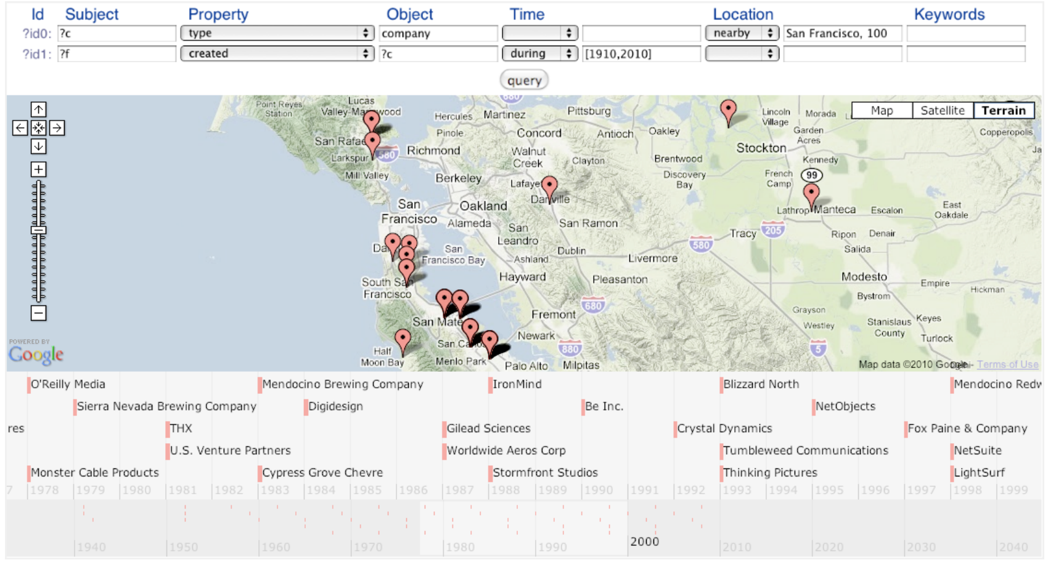
Example:
Hoffart, Johannes & M. Suchanek, Fabian & Berberich, Klaus & Lewis-Kelham, Edwin & de Melo, Gerard & Weikum, Gerhard. (2011). YAGO2: Exploring and Querying World Knowledge in Time, Space, Context, and Many Languages. Proceedings of the 20th International Conference Companion on World Wide Web, WWW 2011.

Slide 14
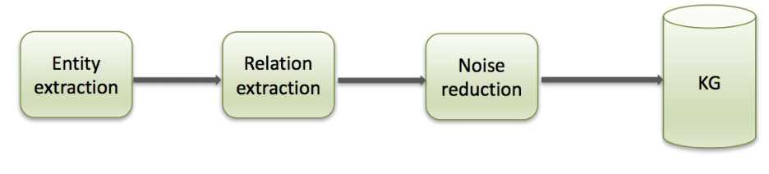
Unstructured Text
Raw text:
Jonathon Watson works at IBM.
Extraction KG construction
http://sumitbhatia.net/source/knowledge-graph-tutorial.html

Slide 15
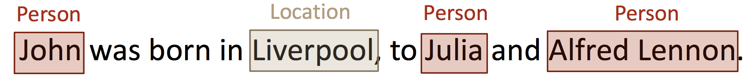
Entity Extraction
Named Entity Recognition
Capture mentions of entities, as well as their type
Similar to POS tagging, but difficult due to inconsistency in labeled data
Hidden Markov Model (HMM), Support Vector Machines (SVM), Conditional Random Fields(CRF), neural methods (Bidirectional LSTM)...
Main Problems:
Different entities with same name
Different names for same entities

Slide 16
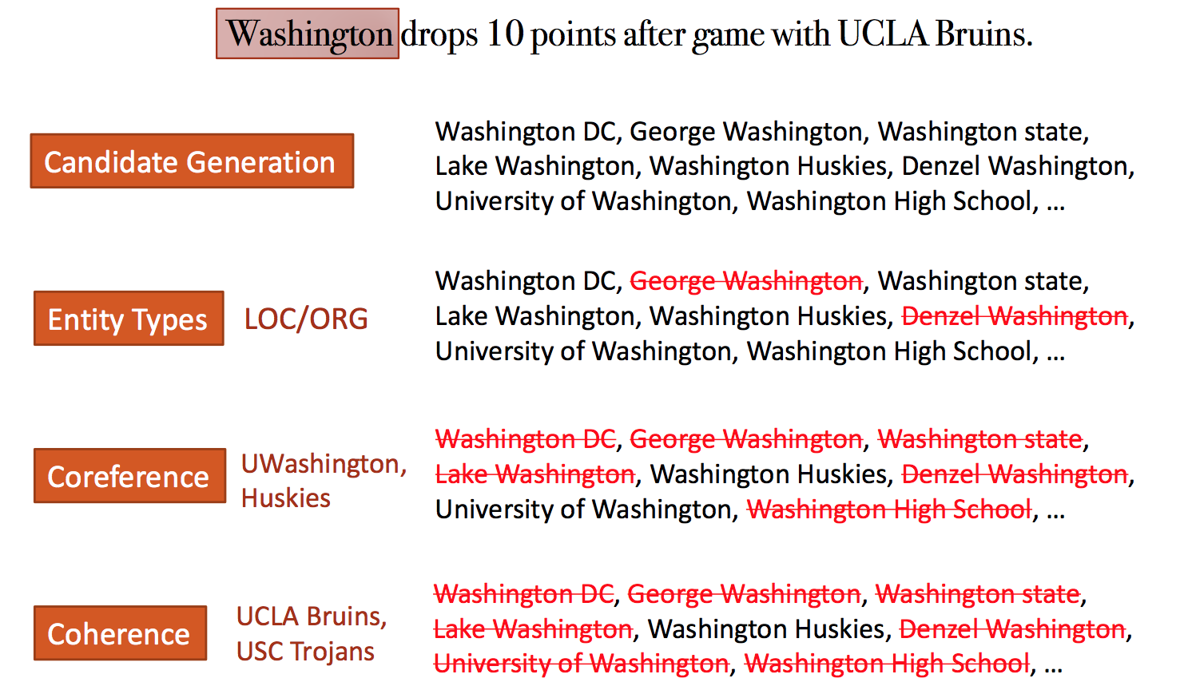
Entity Resolution and Linking
https://kgtutorial.github.io/

Slide 17
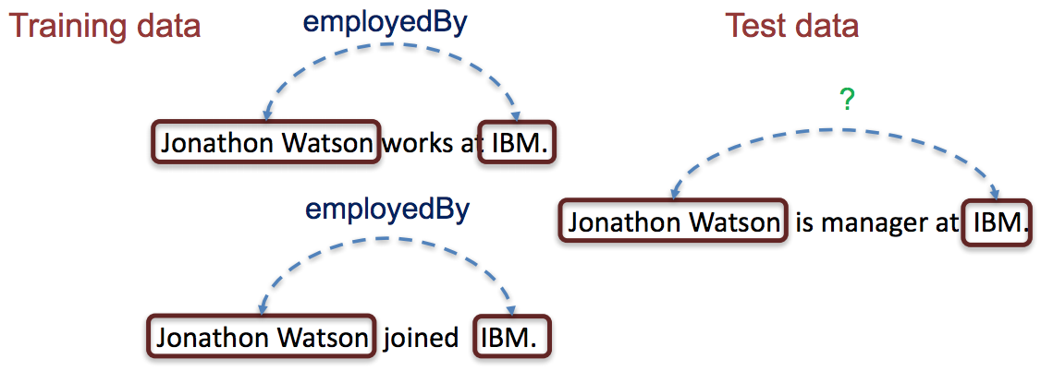
Relation Extraction: Supervised Method
Take the entity mentions and predict the relationship between them
Predefined schema, train on sentences with relationship label
Pros: High accuracy,
less noise
Cons: Expensive to build
labeled data
http://sumitbhatia.net/papers/K

Slide 18
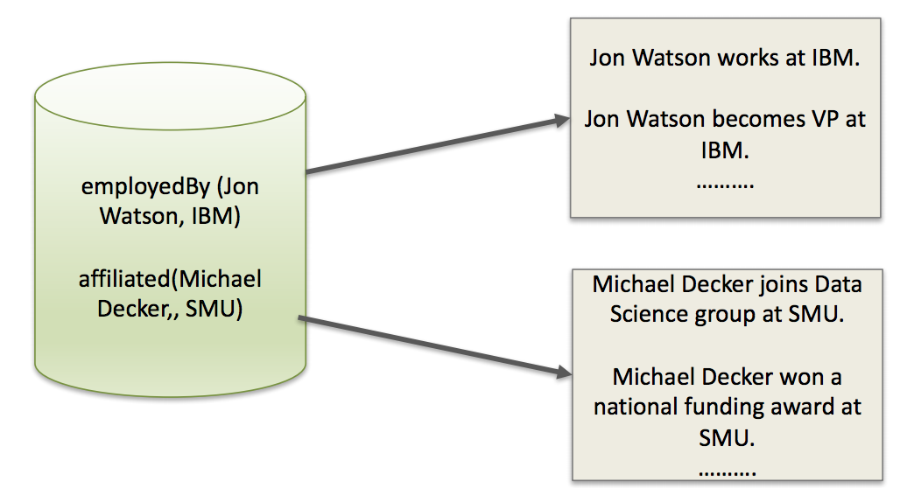
Relation Extraction: Distantly Supervised Method
Collect examples for relations we want to extract from db
Generate training data of positive examples
Generate negative evidence?
Incompatible relations:
B(x,y) => not A(x,y)
Pros: Do not have to label data
Cons: Too noisy

Slide 19
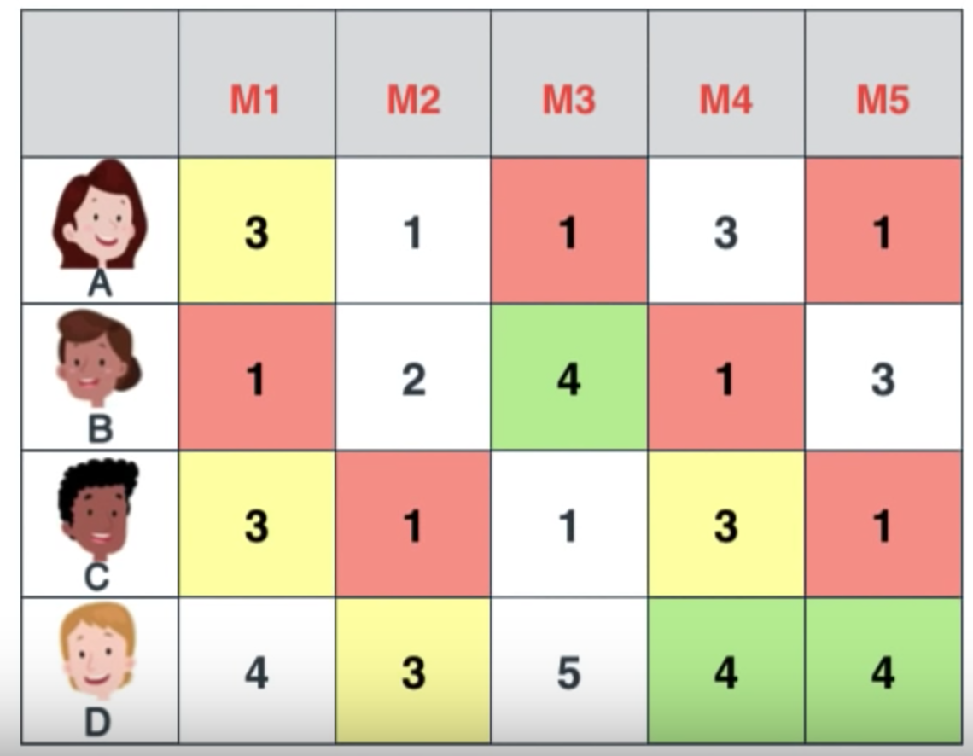
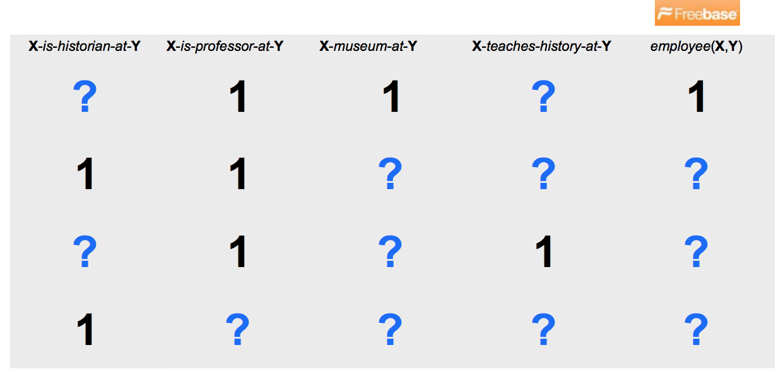
Relation Extraction: Unsupervised Method
Build a KG by using the
Universal Schema = relations of a seed KG (fixed-schema relations)
+ open-domain relations contained in a corpus
Matrix completion: fill in all empty values
https://www.youtube.com/watch?v=ZspR5PZemcs

Slide 20
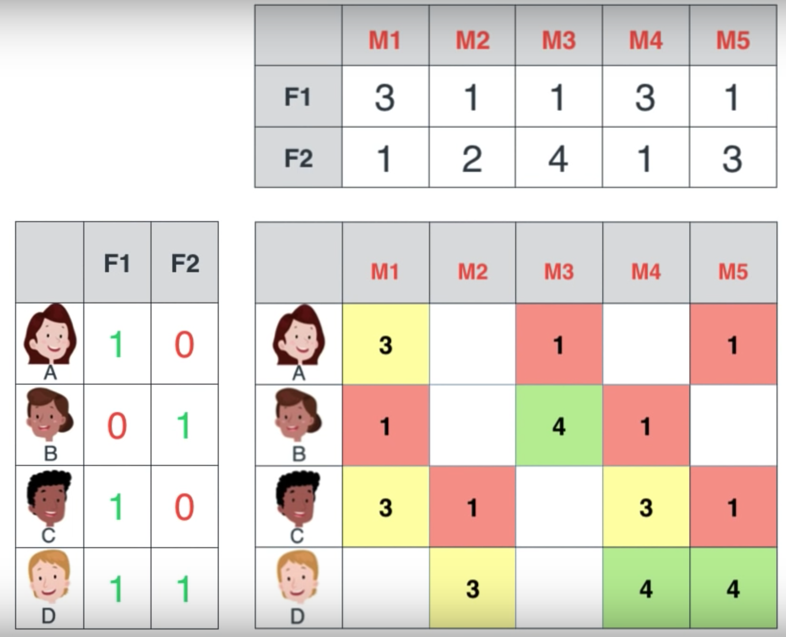
Matrix Factorization
Decompose the large matrix into two small ones

Slide 21
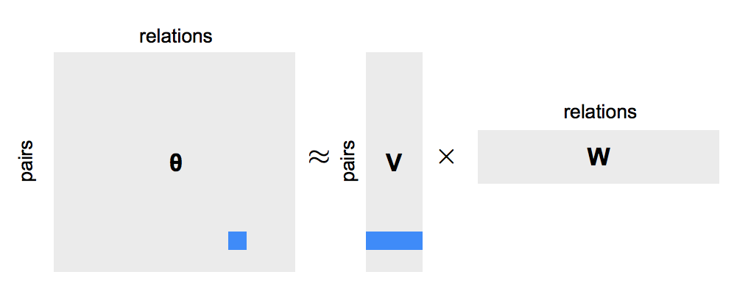
Matrix Factorization
Multiply the two matrices to approximate the original matrix
Because we have more columns (by universal schema), higher accuracy
Does not require distant supervision

Slide 22
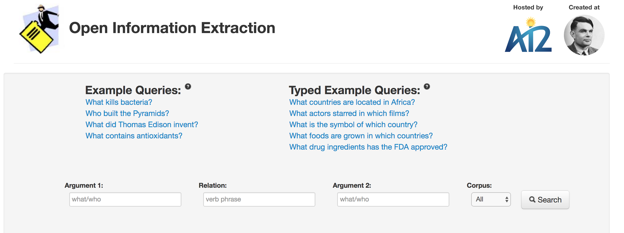
OpenIE
First successful open-source open domain IE system
Extraction of relation tuples from raw text
Schema-free: Relations not predefined; does not require specification of schema
http://openie.allenai.org/

Slide 23
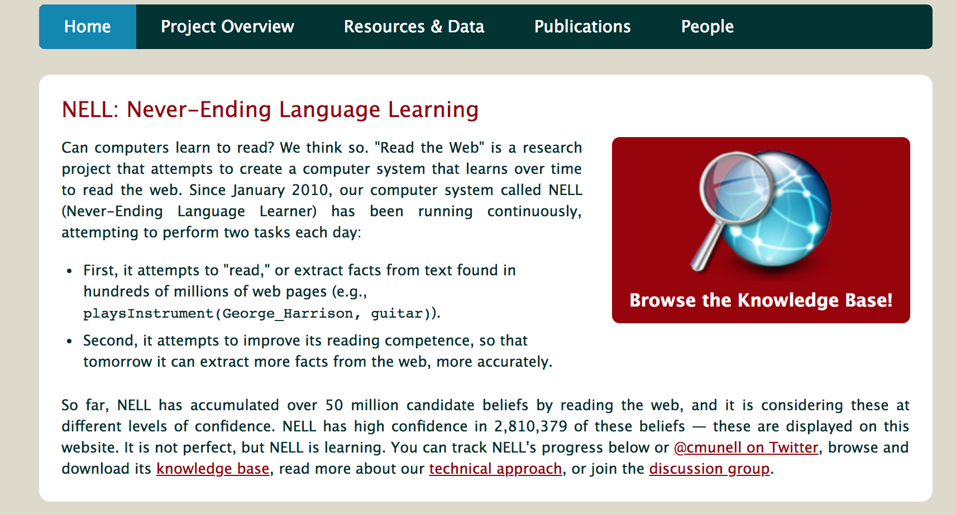

NELL (2010)
Never Ending Language Learning, developed at CMU
Constantly learning since 2010, extracting information from the Web
50 million candidate facts 3 million high-confidence facts
http://rtw.ml.cmu.edu/rtw/
Notes:
https://theglobalscientist.com/2014/05/07/nell-a-machine-that-continuously-reads-learns-and-thinks-by-itself/

Slide 24
KG in Domain
Domain specific entity extraction can be more challenging
Limited relation types
Less explicit mention of entity and relation types in text
Creating simple schema requires domain experts

Slide 25
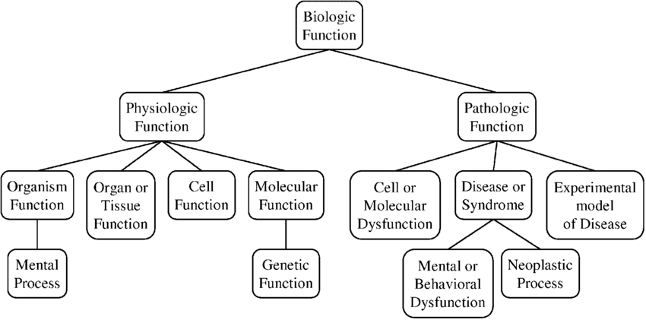
KG in Domain: Biomedical
Unified Medical Language System (1986)
Knowledge base with biomedical terminology and ontology
Metathesaurus: 1 > million biomedical concepts and 5 million concept names
Incorporates multiple controlled vocabulary and classification systems
Semantic Network
Semantic type: organisms, anatomical structures, biologic function, chemicals, etc
Semantic relations: hierarchical (“isa”) + non-hierarchical (conceptual relation, physical relation, etc)
Notes:
https://www.researchgate.net/figure/The-Biologic-Function-sub-tree-in-the-UMLS-Semantic-Network_fig1_51404013

Slide 26
IE → KG Construction
Form triples (head entity, relation, tail entity)
(Melbourne, cityOf, Australia)
Open/Closed world assumptions
Open World Assumptions: undefined triplet is interpreted as unknown
Closed World Assumptions: undefined triplet is interpreted as false
Four main methods of construction
Curated
Collaborative
Automated Semi-structured
Automated Unstructured

Slide 27
Problems
Incorrect knowledge
Wrong label/relationship
Wring fact
Incomplete knowledge
Missing entities/relations
Limited entity and relation types
Inconsistent knowledge
Different labels for same entity
Different entities for same labels

Slide 28
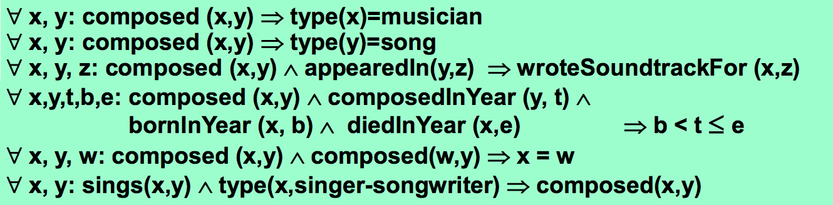
Markov Logic Networks (MLN)
Incorporate first-order ontological constraints and relation patterns
Treat rules as boolean, grounded into formulas
Rules:
https://people.mpi-inf.mpg.de/~weikum/

Slide 29
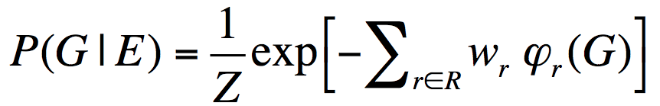
Markov Logic Networks (MLN)
In addition, we have a set of uncertain extracted knowledge
Joint probability distribution over knowledge graph facts, conditioned on the extractions
Attach weights to logical formulas → allow for soft constraints
Optimizing over distribution to find the best KG → NP hard
Approximate with a weighted maxSat solver

Slide 30
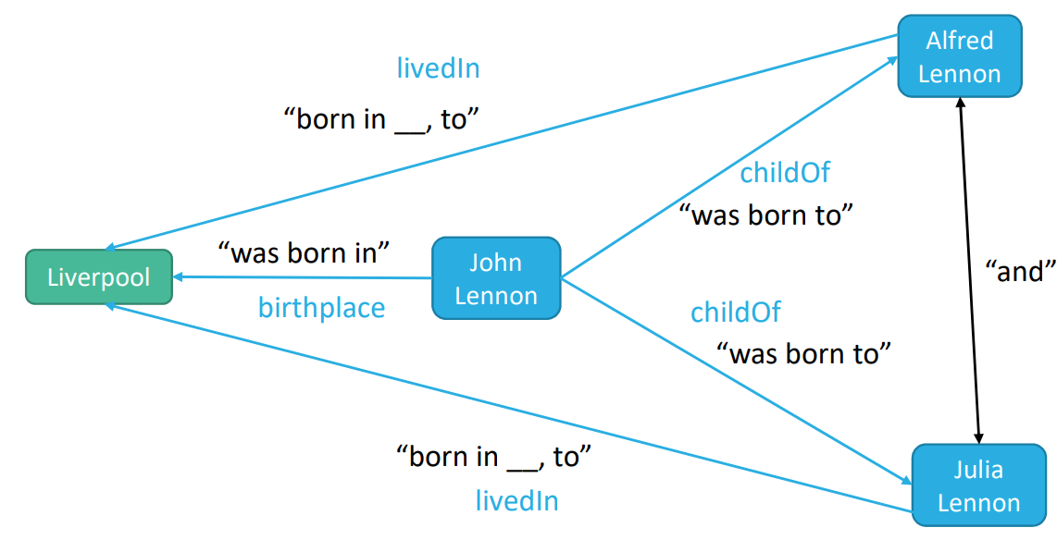
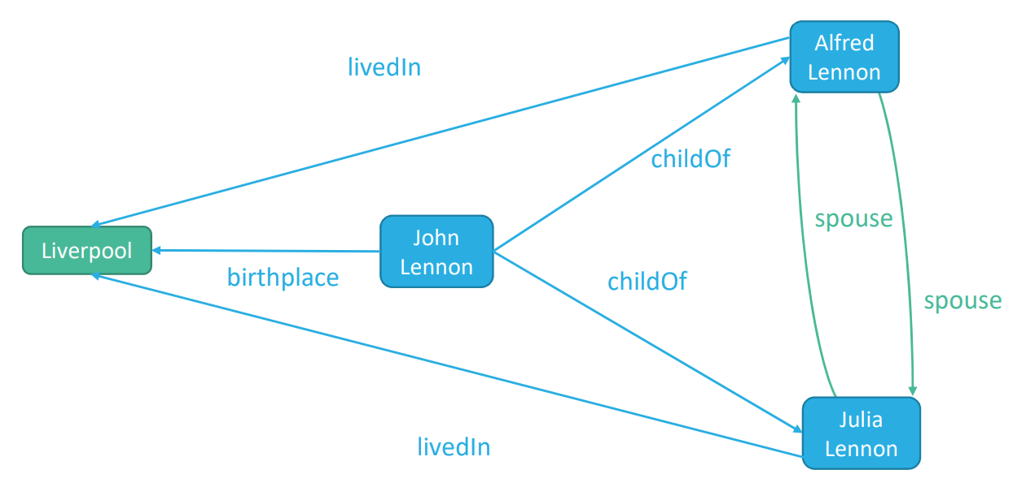
Knowledge Graph Completion
Related to this is the task of filling in missing edges (Link Prediction)
Many KG’s are incomplete
What other methods are there?
(https://kgtutorial.github.io/)

Slide 31
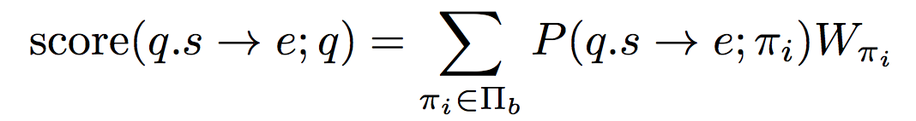
Method: Random Walk
GIven a query of entity and relation, perform random walk the KG → ends when reaching an appropriate goal
Path Ranking Algorithm (2010, Lao et al.)
Performs random walk on imperfect KG
Estimates transition probabilities
For each relation, learns parameters for paths through the KG
Locally grounded
Notes:
THere are too many relational paths in KG → limit path
Pi is each path

Slide 32
Probabilistic Models: downside
Limitation to logical relations
Manual design
Difficult to generalize unseen entities/relations
Computational Complexity
Often NP hard
More rules, more expensive inference
→ use Entity and Relation Embeddings
Can capture many relations
Learned from data

Slide 33
TransE: Translating Embeddings for Modeling Multi-relational Data
Antoine Bordes, Nicolas Usunier, Alberto Garcia-Duran, Jason Weston, Oksana Yakhnenko. NIPS 2013.

Slide 34
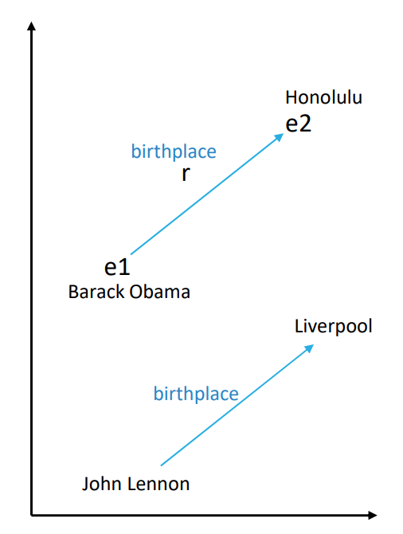
Idea: Translational Embedding
Simple but very powerful baseline model
Models relationships by interpreting them as translations operating on the low-dimensional embeddings of the entities
Similar to Word2Vec (Mikolov et al.)
Triplet (h, r, t) → all embeddings take values in R^k:
Want h + r ≈ t when the relationship holds (t should be h+r’s nearest neighbor, far away otherwise)
(https://kgtutorial.github.io/)

Slide 35
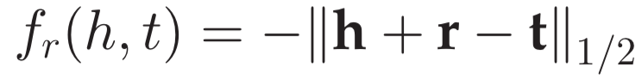
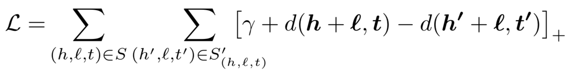
Model
Given a training set of triplets (h, r, t), learn the vector embeddings of the entities and relationships
Simple distant-based scoring function that measures negative distance between h+r and t:
Where score is expected to be large if (h, r, t) holds.
Sample corrupted triplets, which should receive low scores (and rank)

Slide 36
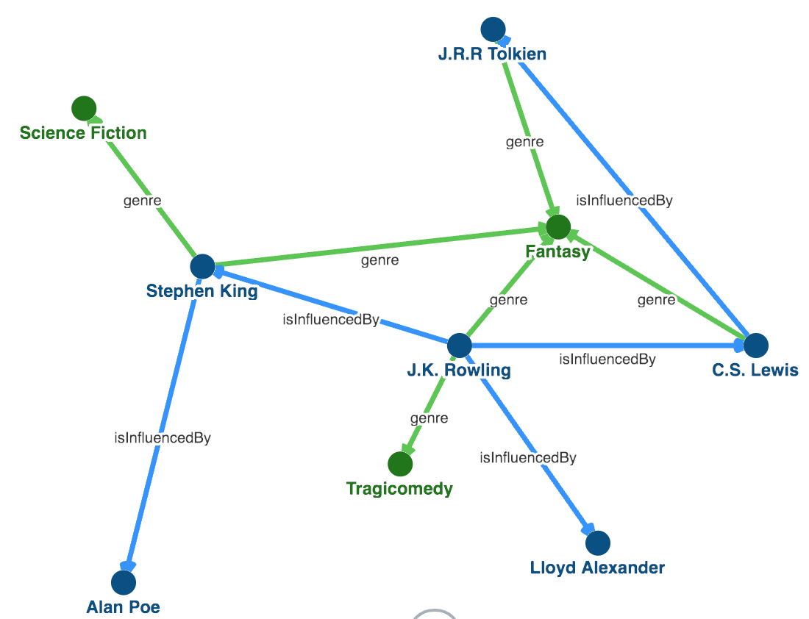
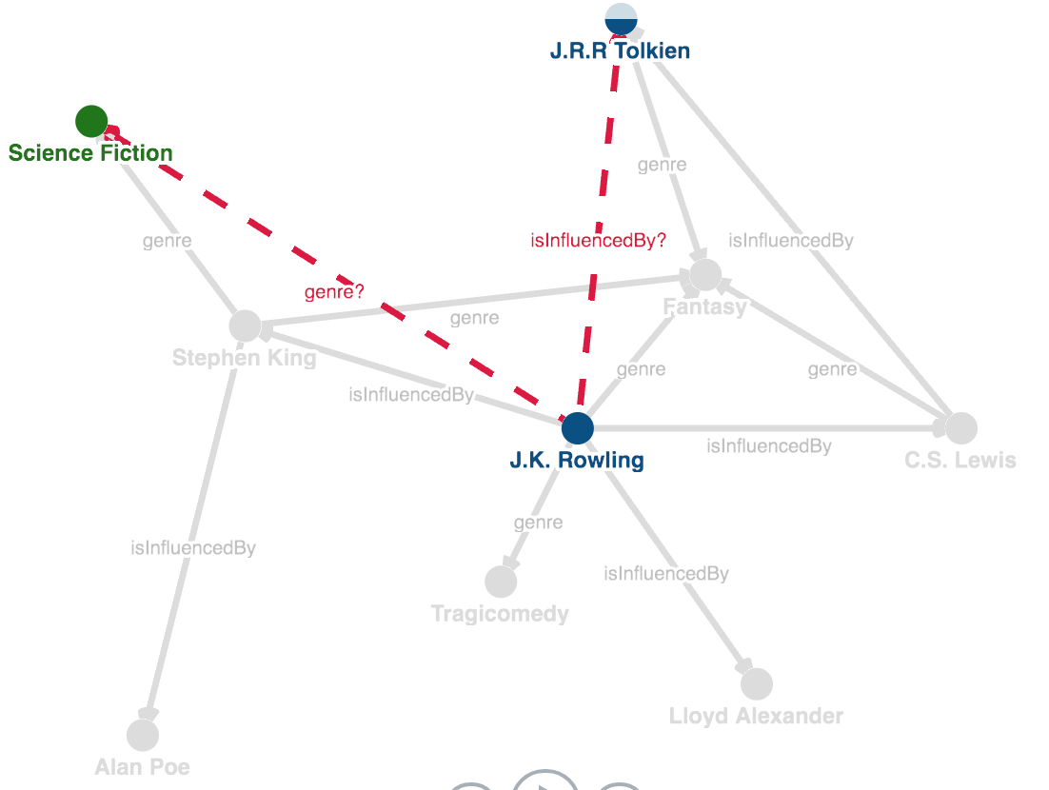
Example
http://pyvandenbussche.info/2017/translating-embeddings-transe/

Slide 37
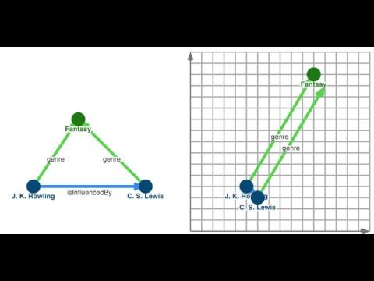
Notes:
http://pyvandenbussche.info/2017/translating-embeddings-transe/

Slide 38
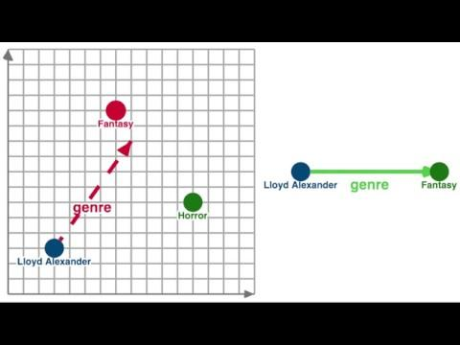

Slide 39
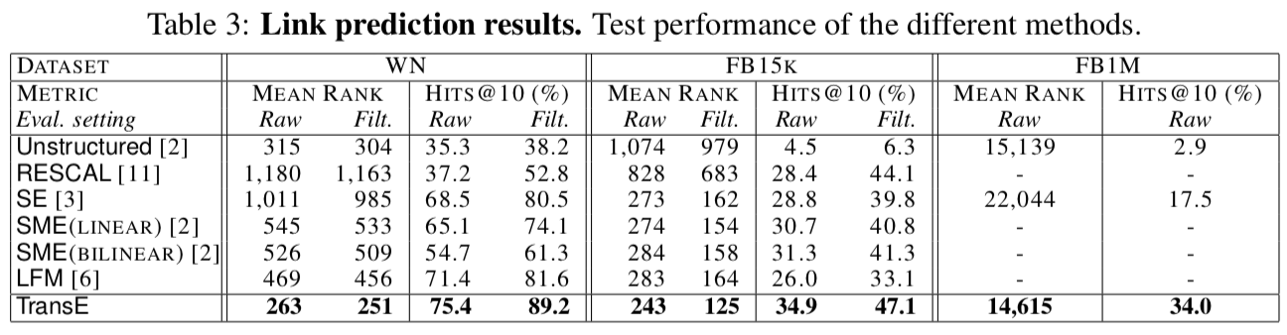
Results
WN: WordNet / FB: Freebase
Mean Rank: mean of predicted rank / Hits @10: % in top ten
Filtered: remove from the list of corrupted triplets all the triplets that appear either in the training, validation or test set
18 relationships 1,345 relationships 23,382 relationships

Slide 40
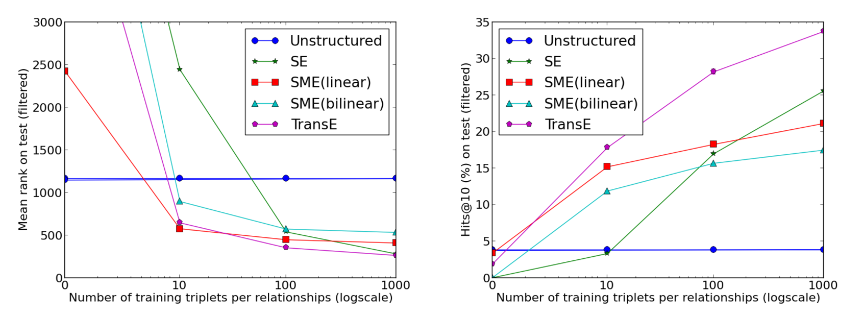
Results
Learning new relationships from few examples

Slide 41
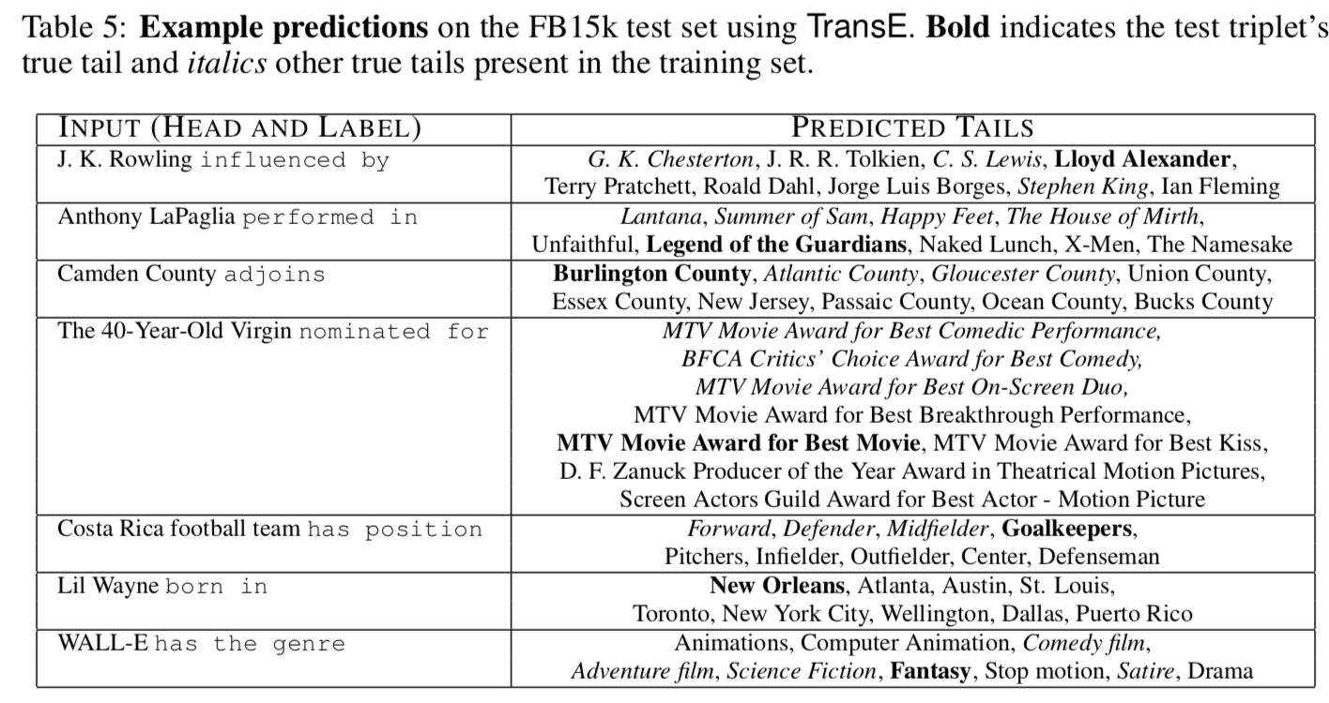
Results

Slide 42
Conclusion
Introduced a translational model for KG embeddings that represent hierarchical relationships
High scalability, works on large scale Freebase data (1M entities)
Significantly outperformed the SOTA methods on link prediction

Slide 43
Related Work
TransH: Knowledge Graph Embedding by Translating on Hyperplanes. Zhen Wang, Jianwen Zhang, Jianlin Feng, Zheng Chen. AAAI 2014.
TransR & CTransR: Learning Entity and Relation Embeddings for Knowledge Graph Completion. Yankai Lin, Zhiyuan Liu, Maosong Sun, Yang Liu, Xuan Zhu. AAAI 2015.
TransD: Knowledge Graph Embedding via Dynamic Mapping Matrix. Guoliang Ji, Shizhu He, Liheng Xu, Kang Liu, Jun Zhao. ACL 2015.
TransA: An Adaptive Approach for Knowledge Graph Embedding. Han Xiao, Minlie Huang, Hao Yu, Xiaoyan Zhu. arXiv 2015.
Notes:
TransE [Bordes et al., 2013] learns the entity and relation embeddings to satisfy r ⇡ t h when (h, r, t) holds.

Slide 44
ConvE: Convolutional 2D Knowledge Graph Embeddings
Tim Dettmers, Pasquale Minervini, Pontus Stenetorp, Sebastian Riedel. AAAI 2018.

Slide 45
Idea: Using CNN to find relations
First model applying CNN to KG embedding
Perform convolution over 2D reshaped embeddings
Related to graph convolutional network
Relational GCN: generalization of GCNs developed for dealing with highly multi-relational data such as KGs
Scoring function (1-N)

Slide 46
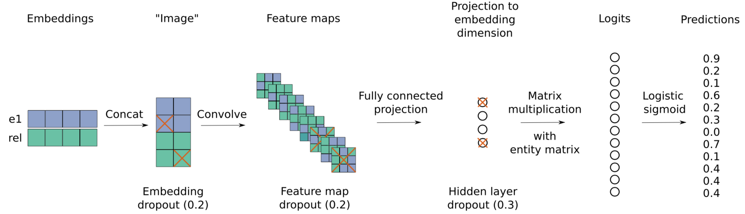
Model
Single convolutional layer, a projection layer, and an inner product layer

Slide 47
Inverse Model
WN18 and FB15k have 94% and 81% test leakage as inverse relations
test triple (feline, hyponym, cat) ⇆ training triple (cat, hypernym, feline)
Authors implemented a simple rule-based inverse model to address this issue

Slide 48
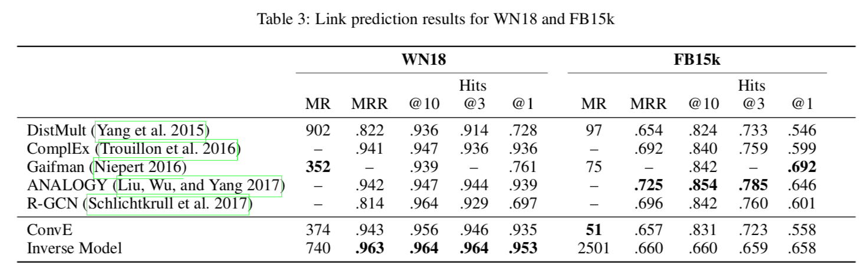
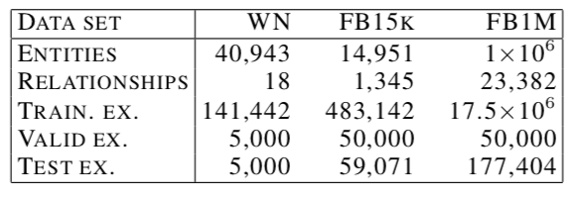
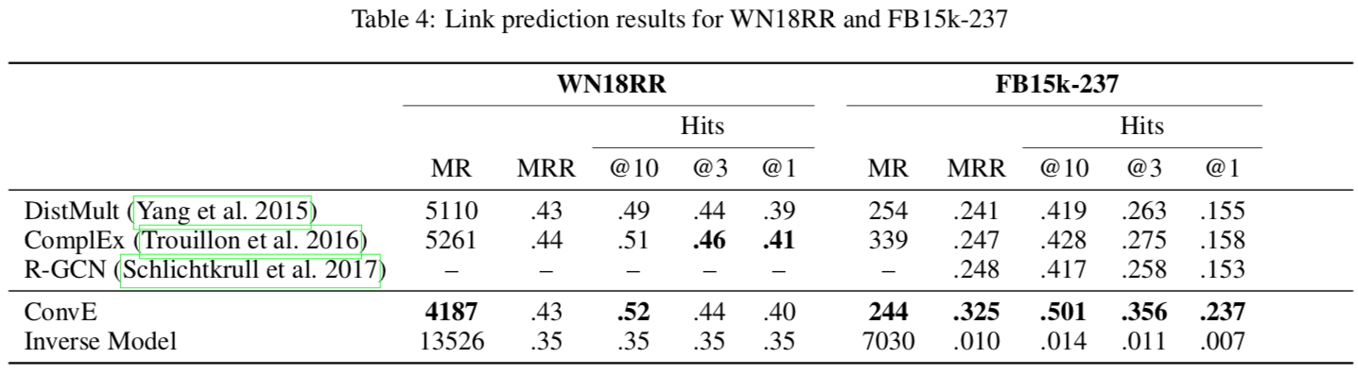
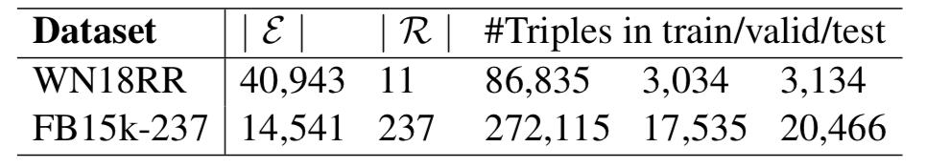
Results
Datasets

Slide 49
Conclusion
ConvE is a link prediction model that uses 2D convolution over embeddings and multiple layers of non- linear features to model knowledge graphs
Reported test leakage where a simple rule-based model can produce good results on certain data sets
Reports SOTA on several modified datasets
Issues
ConvE focuses on the local relationships among different dimensional entries in each entity vector or relation vector

Slide 50
ConvKB: A Novel Embedding Model for Knowledge Base Completion Based on Convolutional Neural Network
Dai Quoc Nguyen, Tu Dinh Nguyen, Dat Quoc Nguyen, Dinh Phung. NAACL-HLT 2018.

Slide 51
Idea: TransE + ConvE
Want to incorporate global relationships and transitional characteristics into the embeddings using CNN
Each triple (head entity, relation, tail entity) is represented as a 3-column matrix where each column vector represents an element of a triple.
A 1 × 3 filter is used to extract relationships between same dimensional entries of the embedding triple.
Scoring function:

Slide 52
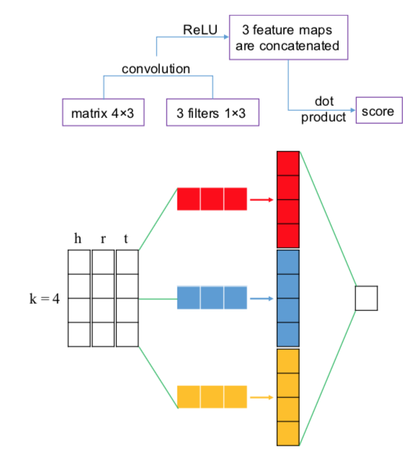
Model
Each entity or relation is associated with unique k dimensional embedding
Create k × 3 input matrix that is fed to the convolutional layer of shape 1 × 3
Produce different feature maps for each row of the input matrix
Concatenate into one feature vector
Produce a score

Slide 53
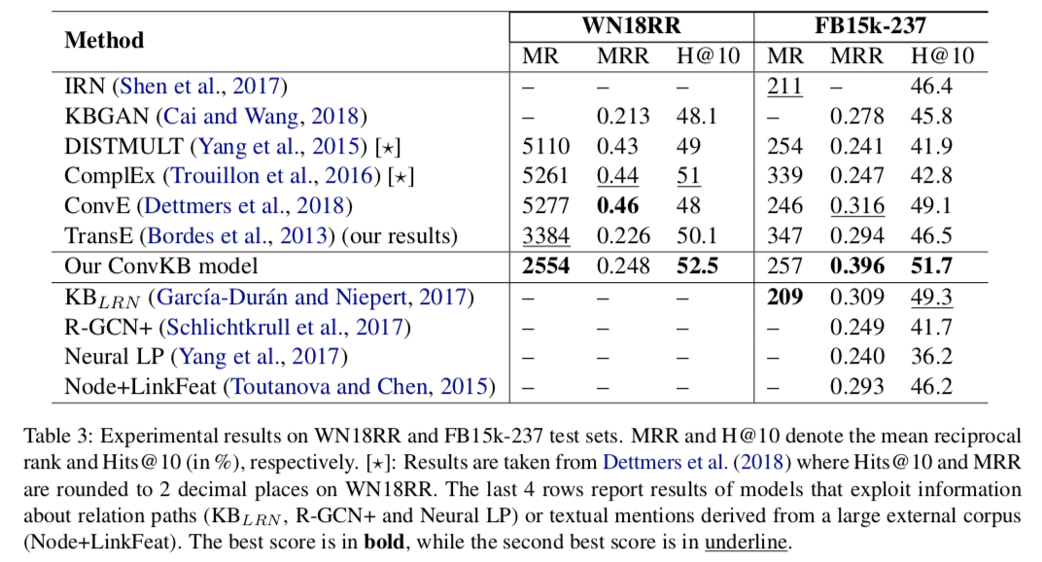
Results

Slide 54
Conclusion
ConvKB applies the CNN to explore the global relationships among same dimensional entries of the entity and relation embeddings, so that it generalizes the transitional characteristics in the TransE.
Obtains better scores than ConvE on both datasets (except MRR on WN18RR and MR on FB15k-237)
Showed the promising future for embeddings methods that incorporate transitional characteristics

Slide 55
Other KG Embedding Models
Enhance embeddings by combining with other information:
Entity Types
TKRL: RL of Knowledge Graphs with Hierarchical Types (Xie et al. 2016)
First attempt to capture the hierarchical types information in KRL
Textual Description
DKRL: Representation Learning of KG with Entity Descriptions (Xie et al. 2017)
Takes advantages of entity descriptions to learn knowledge representations
Logical Rules
RUGE: Knowledge Graph Embedding with Iterative Guidance from Soft Rules (Guo et al. 2018)
Models interactions between embedding learning and logical inference

Slide 56
Applications: Question Answering
KG Embeddings (such as ConvE) do well in one-hop reasoning
Some questions require multi-hop reasoning
The actor of Ruby Cairo also starred in which films?
Ruby Cairo (1992) → Andie MacDowell → Green Card(1990)
Incomplete KG produces false negatives that hindures multi-hop reasoning
→ Reinforcement Learning
Soft rewards: Estimate the presence of unobserved facts

Slide 57
Other Applications
Semantic Search and Ranking
Enhance search results
Enable predictive searching
Recommender Systems
Combine user-item interactions with auxiliary information about user/item contained in the KG

Slide 58
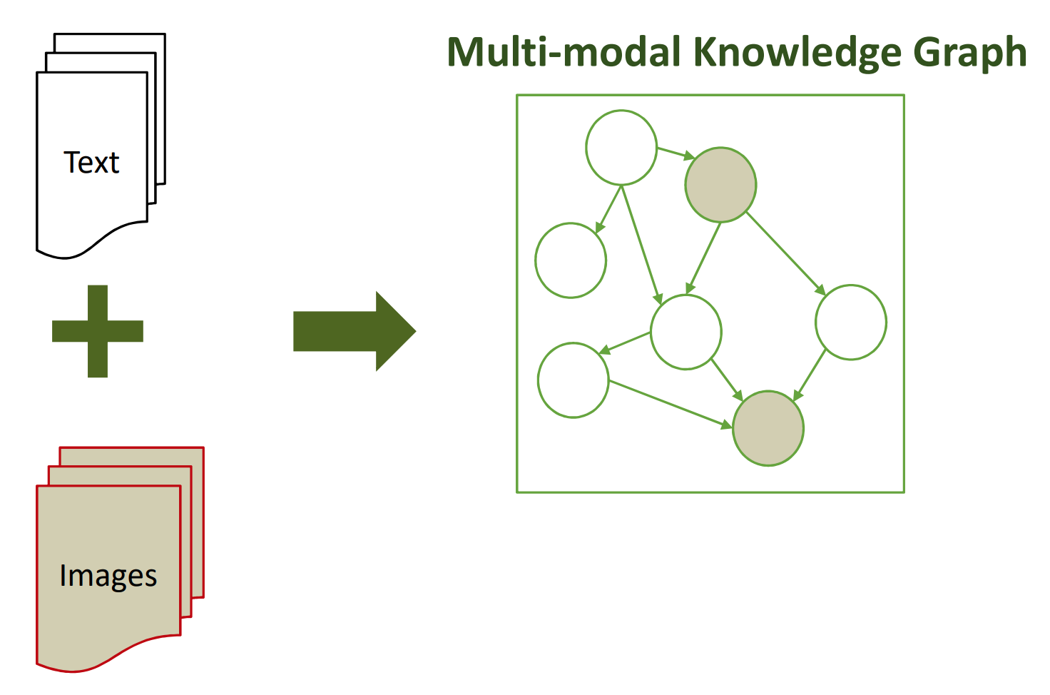
Future Research
Going beyond facts
Event frame: how, when, and where?
Process: larger structure, sequence of events (e.g. Photosynthesis)
Multi-Modal Information Extraction
NEIL: Extracting Visual Knowledge from Web Data (CMU)
WebChild: Text + Images

Slide 59
Discussion
Which NLP tasks benefit from the improvement of knowledge graphs?
There are many approaches to knowledge graph embedding (TransE, ConvE, ConvKB...), what other methods can you think of?
By its nature of construction, a typical knowledge graph is biased towards including frequently occurring entities and relations. How can you control the biased growth of knowledge graphs?
What other downstream applications (NLP task or commercial usage) of knowledge graphs might be interesting to look into?

